Slide 1
Unsupervised Representation Learning With Deep Convolutional Generative Adversarial Networks
Ha-larm

Slide 2
Supervised Learning(labeling)의 강세..
Unsupervised Learning(clusterling)은??
Candidate
=>DCGANS(deep convolutional generative adversarial networks)

Slide 3
Past: CNN+GAN(scale up) -> Fail!
So,,,
1.Upscale and low resolution
2.Allowed higher resolution set
And deeper generative model

Slide 4
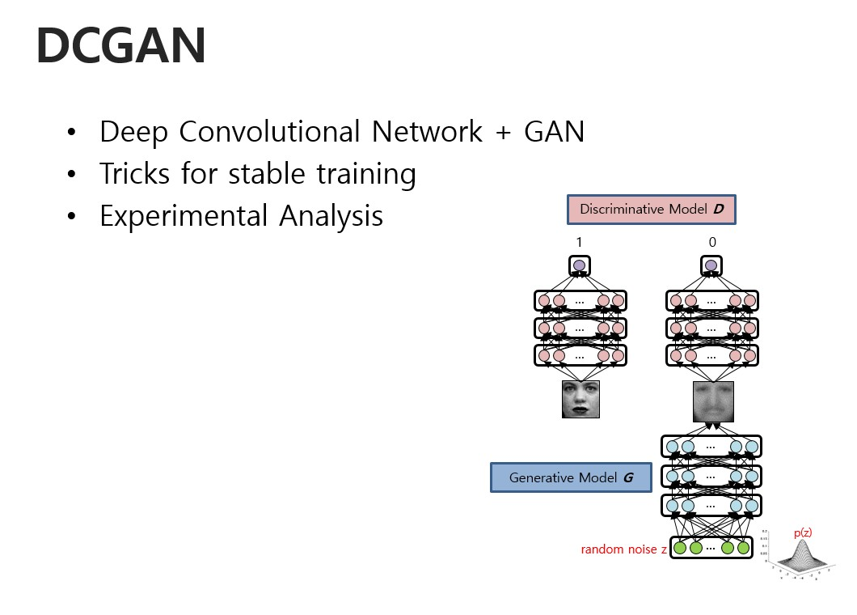

Slide 5
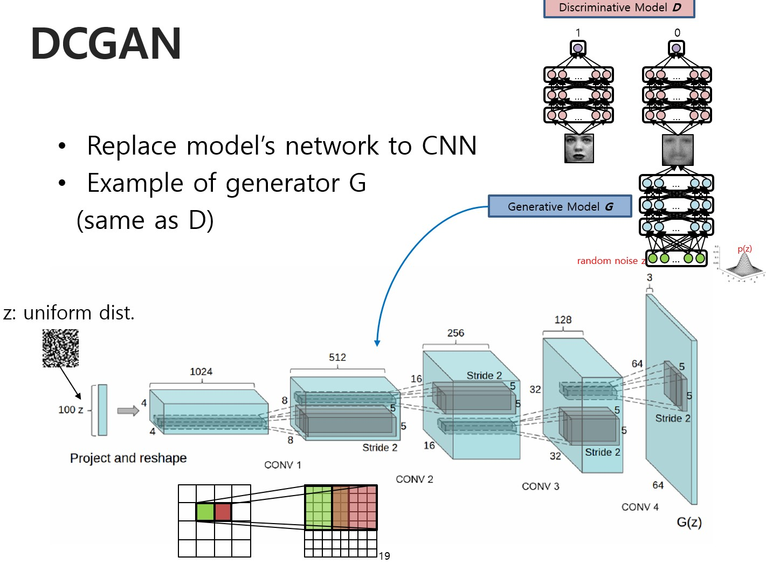

Slide 6
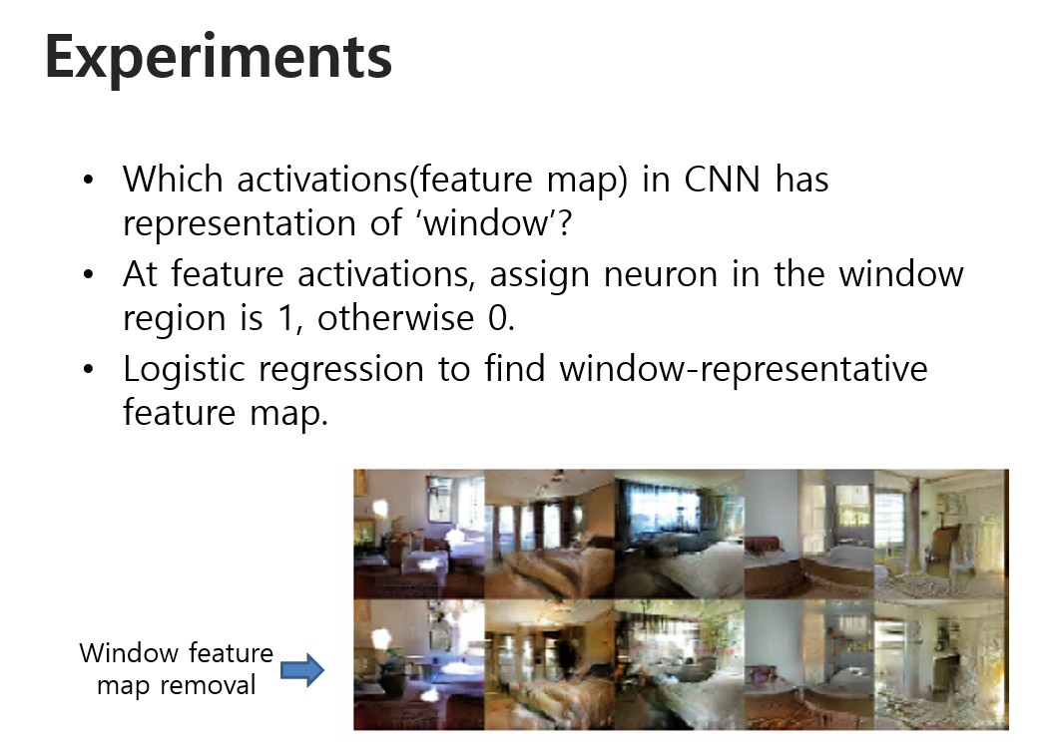

Slide 7
REPRESENTATION LEARNING FROM UNLABELED DATA
=>hierarchical clustering of image patches
2. GENERATING NATURAL IMAGES
3. VISUALIZING THE INTERNALS OF CNNS
=>using a gradient descent on the inputs lets us inspect the ideal image that activates certain subsets of filters

Slide 8
Model Structure
1.Convolutional net
=>network to learn its own spatial downsampling
(Using at generator)
2.Eliminating fully connected layers on top
3. Batch Normalization
=>stabilizes learning by normalizing the
input to each unit

Slide 9
해상도의 향상
=>overfitting concern(LSUN data-set,high resolution )
중복제거
To further decrease the likelihood of the generator
memorizing input examples

Slide 10
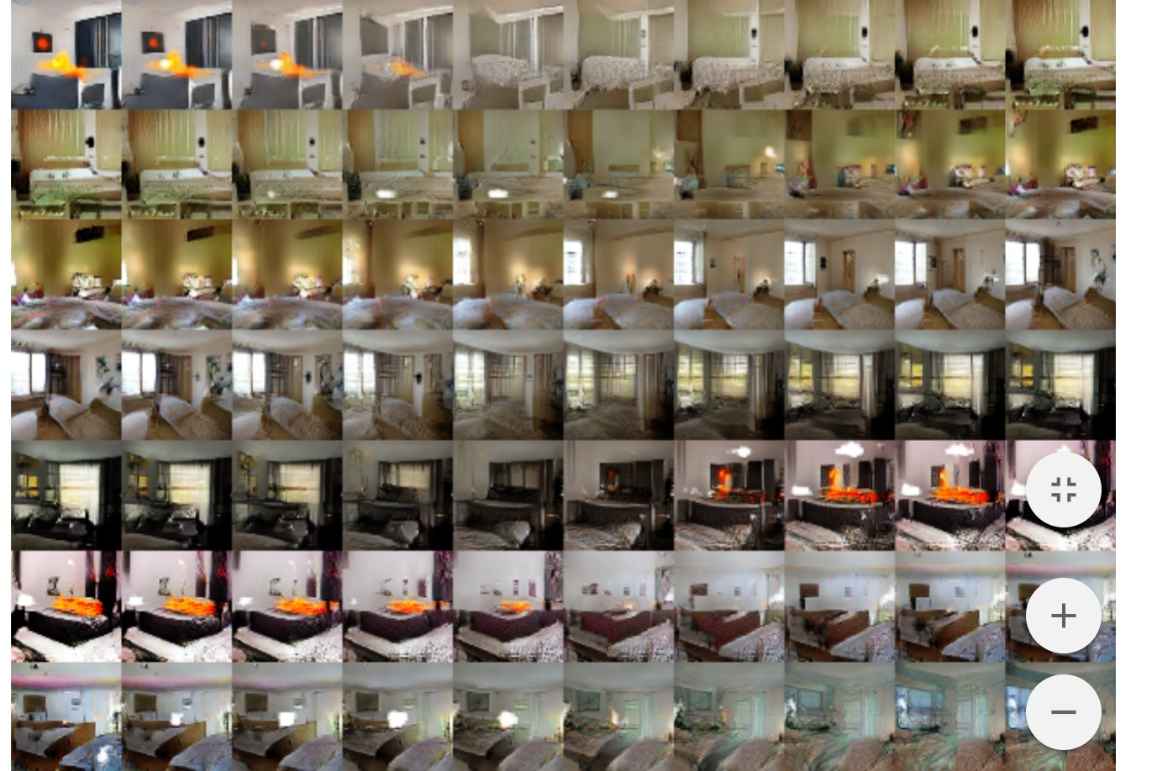

Slide 11
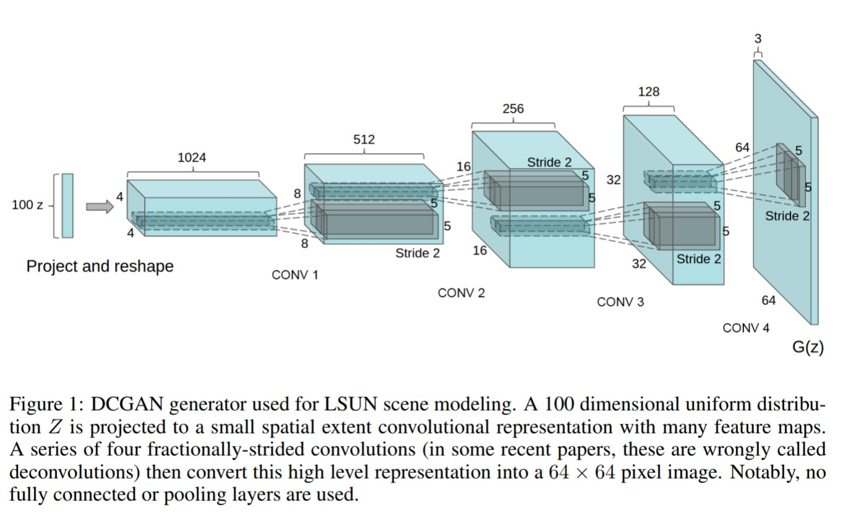

Slide 12
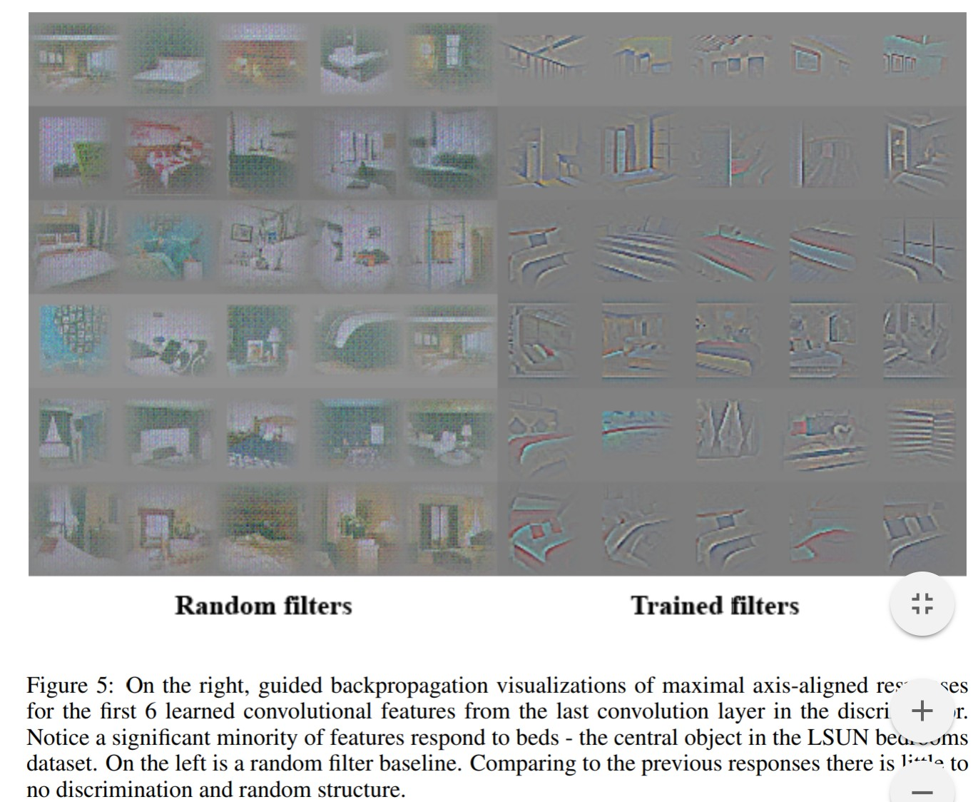

Slide 13
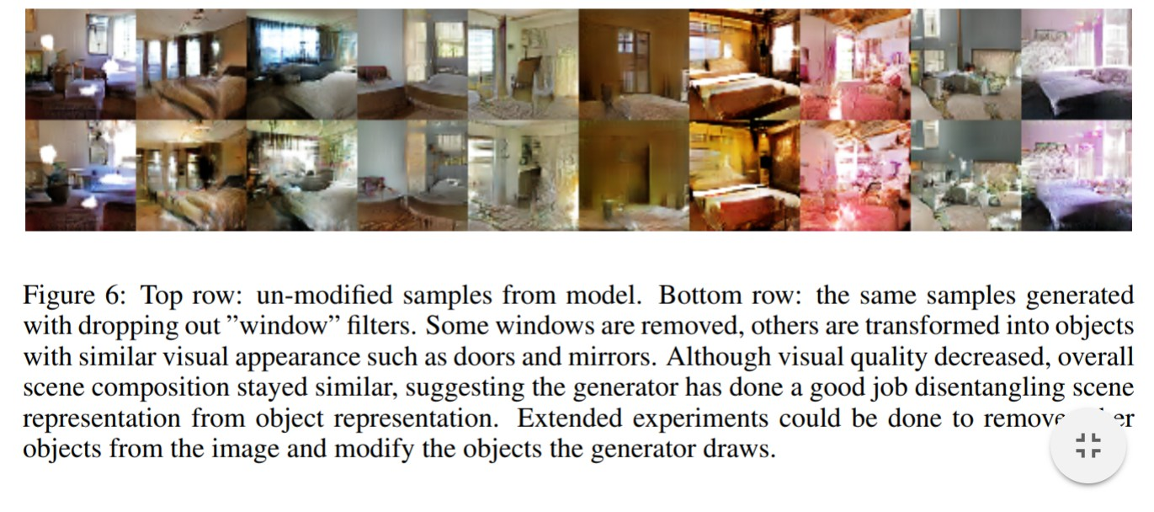
Vector algorithm could dramatically reduce the amount of data
needed for conditional generative modeling of complex image distributions.

Slide 14
Conclusin
1.Propose more stable set of architectures for training generative adversarial networks
2.give evidence that adversarial networks learn good representations of images for supervised learning and generative modeling

Slide 15
Q & A

Slide 16
Thank you!
Reference: UNSUPERVISED REPRESENTATION LEARNING WITH DEEP CONVOLUTIONAL GENERATIVE ADVERSARIAL NETWORKS
Ref:https://github.com/sjchoi86

